Slide 1
CS5486
Intelligent Systems
Prof. Jun Wang
Department of Computer Science
Tel: 3442 9701
Email: jwang.cs@cityu.edu.hk

Slide 2
Aims
This course aims to equip students with the skills of problem solving using artificial intelligence (AI) techniques through a demonstrable knowledge in a range problem solving methods and the associated knowledge representation and machine learning techniques.
CS5486

Slide 3
Keywords
Artificial intelligence vs. computational intelligence. Neural networks. Knowledge representations. Machine learning. Rule-based systems. Fuzzy Systems. Evolutionary computation.
CS5486

Slide 4
Syllabus
An introduction to the goals and objectives of AI as a discipline and its milestones. Approaches in AI. Major components in intelligent systems.
Methods of knowledge acquisition and representations. Associative memory. Techniques on machine learning such as supervised learning, unsupervised learning, reinforcement learning, and deep learning. Generalization.
CS5486

Slide 5
Syllabus (cont’d)
Basic concepts of graph and tree search. Optimization methods such as stochastic annealing, neurodynamic optimization, genetic algorithm, particle swarm optimization, ant colony optimization, and differential evolution.
CS5486

Slide 6
References
R. Rojas, Neural Networks: A Systematic Introduction, Springer, 1996.
S. Haykin, Neural Networks and Learning Machines (3rd Ed), Prentice-Hall, 2009.
S. Russell and P. Norvig, Artificial Intelligence: A Modern Approach. 3rd Ed. Prentice-Hall (2009)
C.-T. Lin and C.S. G. Lee, Neural Fuzzy Systems, Prentice-Hall, 1996.
CS5486

Slide 7
Intelligence
“Intelligence is a mental quality that consists of the abilities to learn from experience, adapt to new situations, understand and handle abstract concepts, and use knowledge to manipulate one’s environment.”
Britannica
CS5486

Slide 8
Definition of Intelligent Systems
    A system is an intelligent system if it exhibits some intelligent behaviors.
    For example, neural networks, fuzzy systems, simulated annealing, genetic algorithms, and expert systems.
CS5486

Slide 9
Intelligent Behaviors
Inference: Deduction vs. Induction (generalization); e.g., judgment and pattern recognition
Learning and adaptation: Evolutionary processes; e.g., learning from examples
Creativity: e.g., planning and design
CS5486

Slide 10

CS5486

Slide 11
Milestones of Intelligent System Development
1940’s: Cybernetics by Wiener
1943: Threshold logic networks by McCulloch and Pitts
1950’s-1960’s: Perceptrons by Rosenblatt
1960’s Adaline by Widrow
1970’s: AI and Expert systems
1970’s: Fuzzy logic by L. Zadeh
1974: Back propagation algorithm by P. Werbos
1970’s: Adaptive resonance theory by S. Grossberg
1970’s: Self-organizing map by T. Kohonen
1980’s: Hopfield networks by J. Hopfield
1980’s: Genetic algorithms by J. Holland
1980’s: Simulated annealing by Kirkpatrick et al.
2006-: Deep learning by Hinton et al.
CS5486

Slide 12
Milestones (cont’d)
Deep Blue (IBM), 1997 defeated chess world champion Garry Kasparov
Alpha Go (Google), 2016 defeated go nine dan Sedol Lee
CS5486

Slide 13
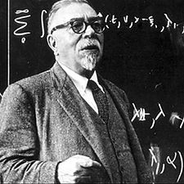
Professor Norbert Wiener
CS5486

Slide 14
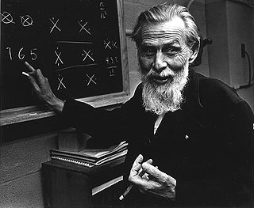
Professor Warren S. McCulloch
CS5486

Slide 15
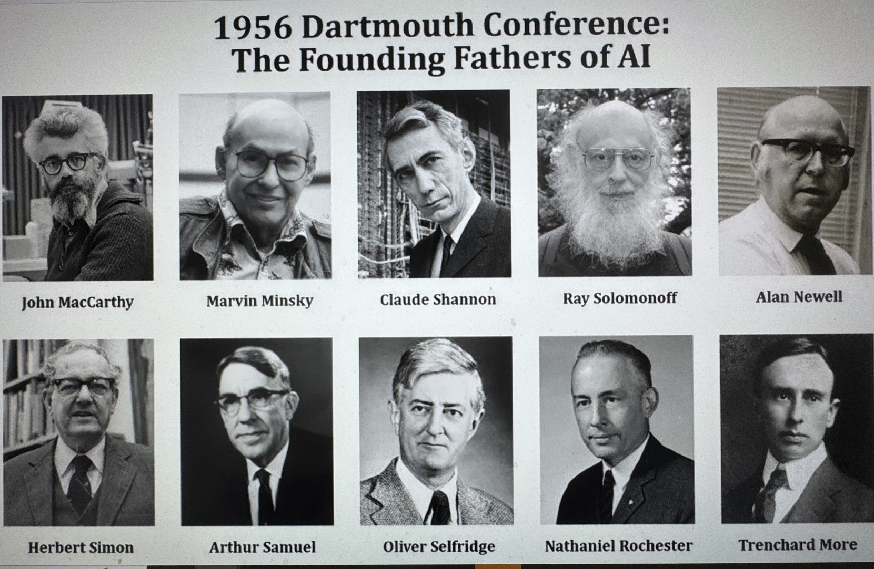
The Birth of “AI”
CS5486

Slide 16
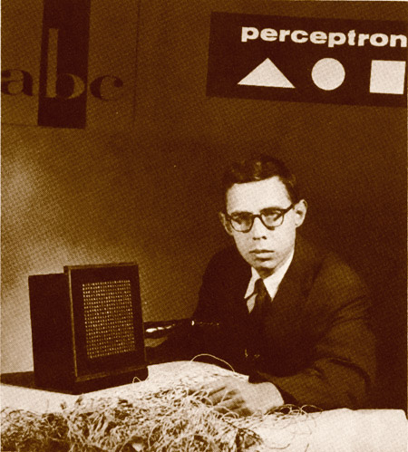
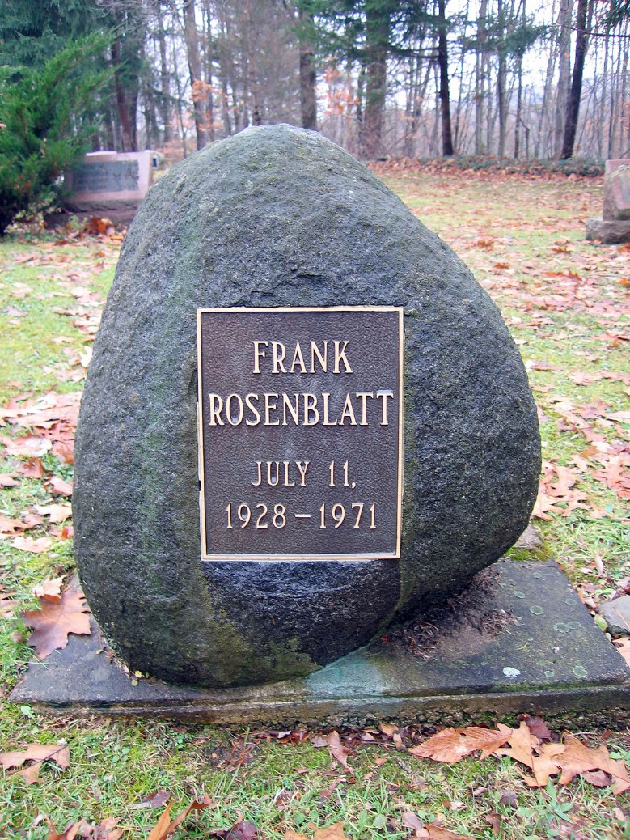

Professor Frank Rosenblatt
CS5486

Slide 17
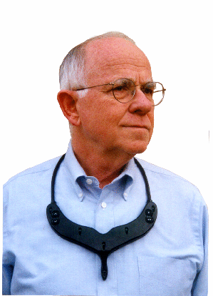
Professor Bernard Widrow
CS5486

Slide 18
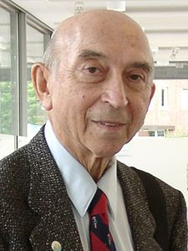
Professor Lofti A. Zadeh
CS5486

Slide 19

Dr. Paul J. Werbos
CS5486

Slide 20
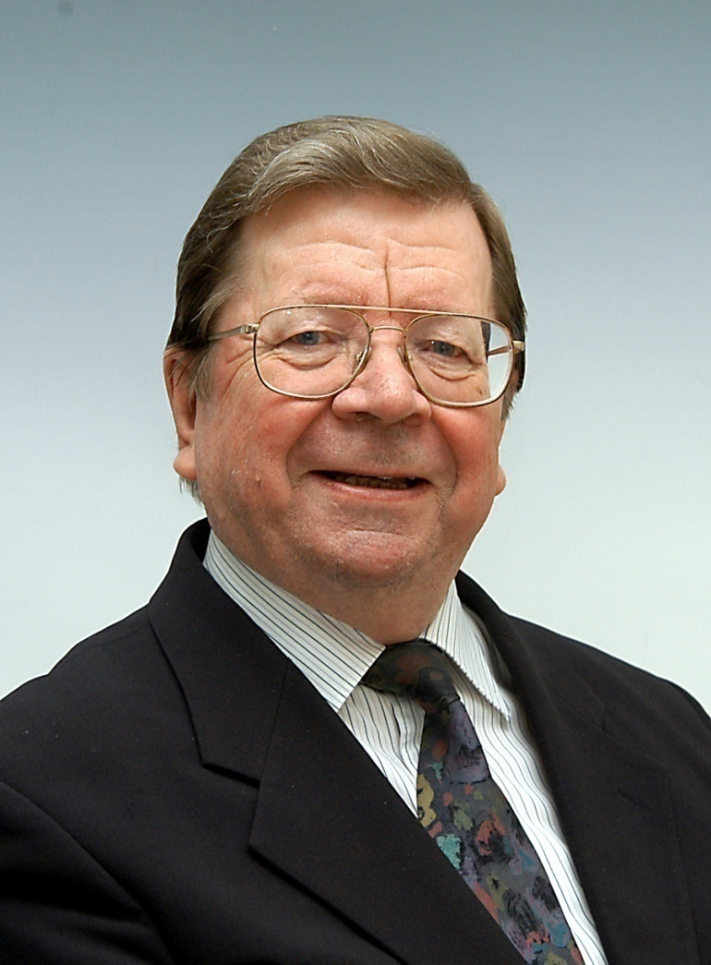
Professor Teuvo Kohonen
CS5486

Slide 21
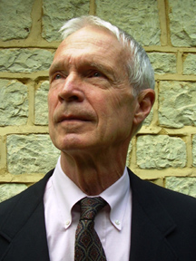
Professor John J. Hopfield
CS5486

Slide 22

Professor Jeffrey E. Hinton
CS5486

Slide 23
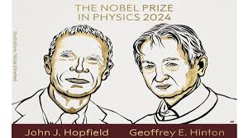
2024 Nobel Prize in Physics
“…foundational discoveries and inventions that enable machine learning with artificial neural networks”.
CS5486

Slide 24

2024 Nobel Prize in Chemstry
D. Baker, D. Hassabis, and J. Jumper
for their contribution to “computational protein design” and “protein structure prediction”.
CS5486

Slide 25
Applications of Intelligent Systems
Pattern recognition: e.g., image processing, pattern analysis, speech recognition, etc.
Control and robotics: e.g., modeling and estimation
Associative memory (content-addressable memory)
Forecasting: e.g., in financial engineering
CS5486

Slide 26



Generative AI
CS5486

Slide 27
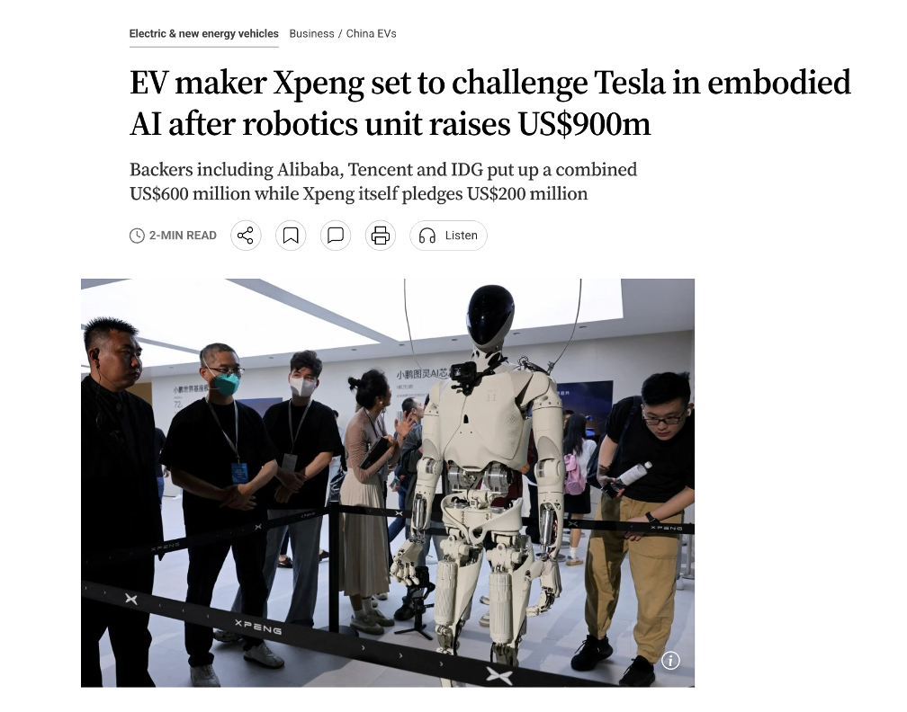
Embodied AI
CS5486

Slide 28
AI and Other Sciences

Slide 29
Computational Intelligence
Coined by IEEE Neural Networks Council in 1994.
Represent a new generation of intelligent systems.
Consist of Neural Networks, Fuzzy Logic, and evolutionary computing techniques (genetic algorithms).
CS5486

Slide 30
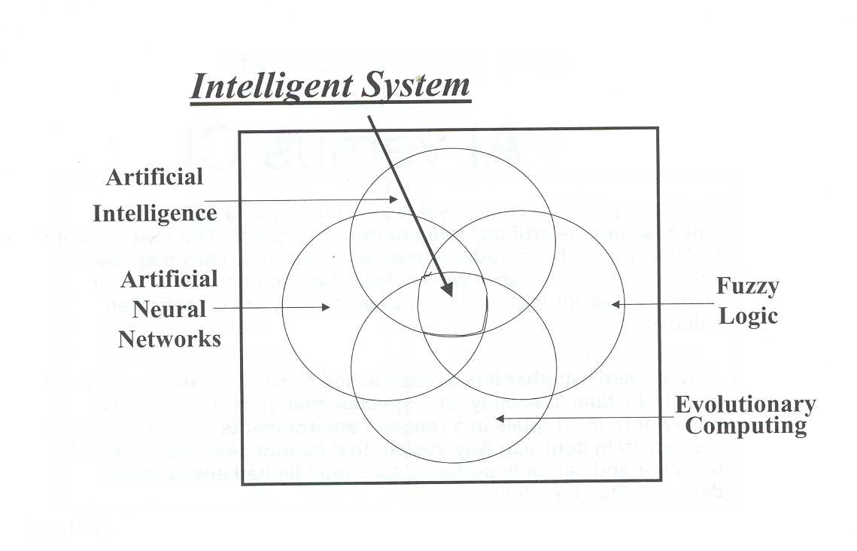

Slide 31
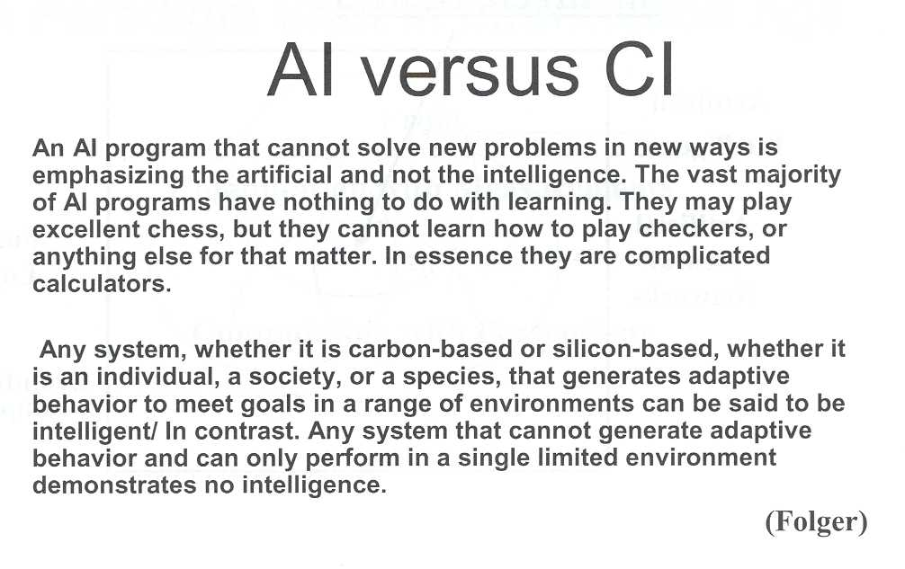

Slide 32
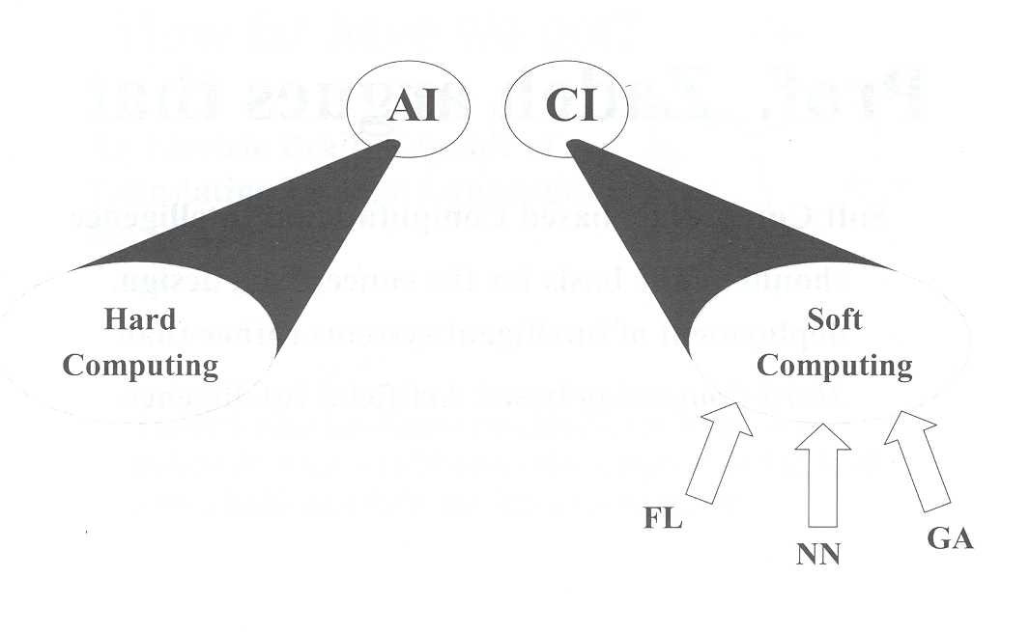
CS5486

Slide 33
Soft Computing
“Soft computing based on computational intelligence should be the basis for the conception, design, deployment of intelligent systems rather than hard computing based on artificial intelligence.”
Lofti Zadeh
CS5486

Slide 34
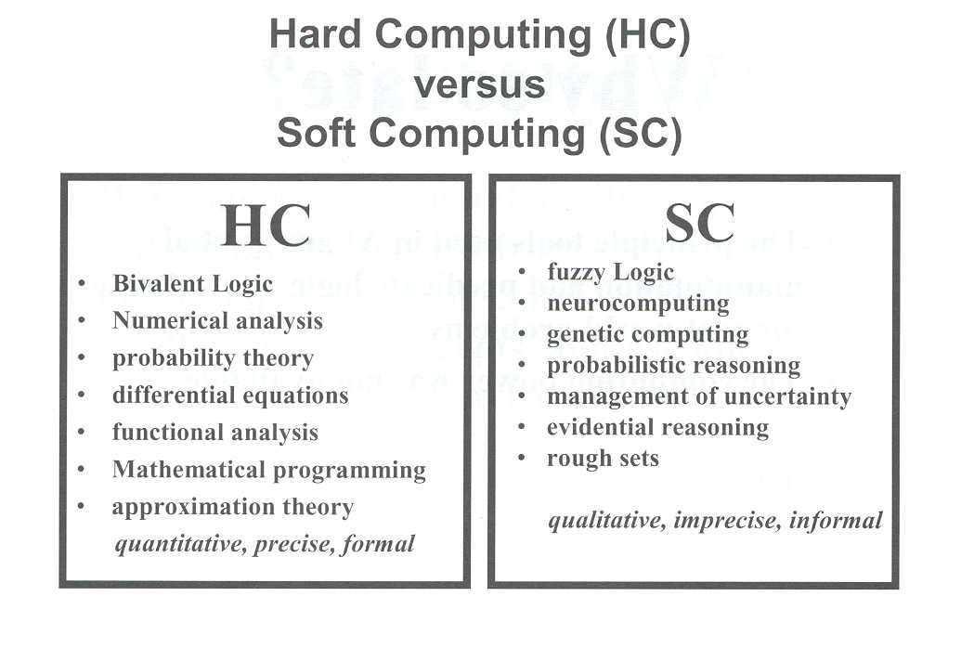
CS5486

Slide 35
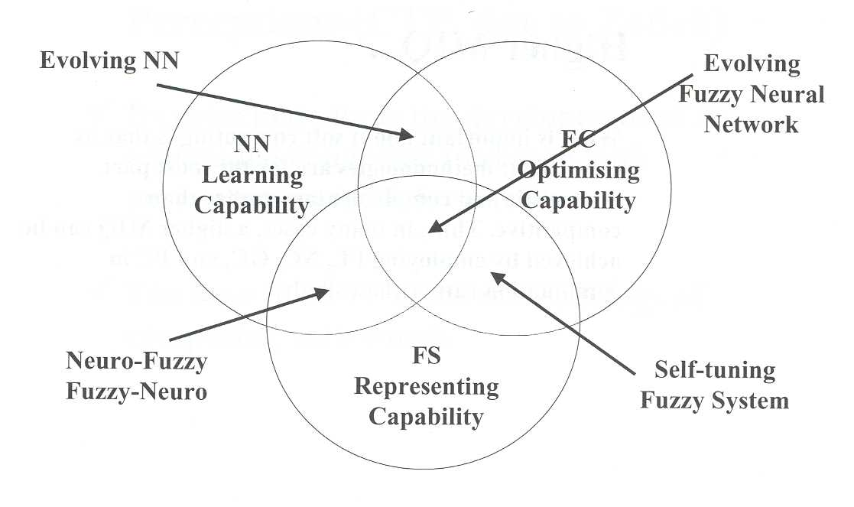
CS5486

Slide 36
What are Neural Networks?
Composed of a number of interconnected neurons, resembling the human brain.
Also known as connectionist models, parallel distributed processing (PDP) models, neural computers, and neuromorphic systems.
CS5486

Slide 37
Components of Neural Networks
A number of artificial neurons (also known as nodes, processing units, or computational elements)
Massive inter-neuron connections with different strengths (also known as synaptic weights).
Input and output channels
CS5486
CS5486

Slide 38
Formalization of Neural Networks
ANN = (ARCH, RULE)
ARCH: architecture, refers to the combination of components
RULE: rules, refers to the set of rules that relate the components
CS5486

Slide 39
Architecture of Neural Networks
ARCH = (u, v, w, x, y)
Simple and alike neurons represented by u and v in N-dimensional space
Inter-neuron connection weights represented by w in M-dimensional space
External input and outputs represented respectively by x and y in n and m-dimensional space
CS5486

Slide 40
Model of Neurons
Biological neurons: 10¹⁰-10¹¹
Highly simplified
Fire activities are quantified by using state variables (also called activation states)
Net input to a neuron is usually a weighted sum of state variables from other neurons, input and/or output variables
Net input to a neuron usually goes thru a nonlinear transformation called activation
CS5486

Slide 41
Connections between Neurons
Adaptive: Synaptic connections with adjustable weights
Excitatory (positive weight) vs. inhibitory (negative weight)
Distributed knowledge representation, different from digital computers
CS5486

Slide 42
Rules of Neural Networks
RULE = (E, F, G, H, L)
E: Evaluation rule mapped from v and/or y to a real line; e.g., error function or energy function
F: Activation rule mapped from u to v; e.g., activation function
G:Aggregation rule mapped from v, w, and/or x to u; e.g., weighted sum
H: output rule mapped from v to y, y usually is a subset of v
L: Learning rule mapped from v, w, and x to w, usually iterative
CS5486

Slide 43
Learning in Neural Networks
Goal: To improve performance
Means: interact with environment
A process by which the adaptable parameters of an ANN are adjusted thru an iterative process of stimulation by the environment in which the ANN is embedded
Supervised vs. unsupervised
CS5486

Slide 44
On Learning
“By three methods we may learn wisdom: First, by reflection, which is the noblest; second, by imitation, which is the easiest, and third by experience, which is the bitterest.”
Confucius 孔子
CS5486

Slide 45
General Incremental Learning Rule
Discrete-time:
Continuous-time:
CS5486

Slide 46
Two-Time Scale Dynamics in Neural Networks
Faster dynamics in neuron activities represented by u and v. Also called short-term memory
Slower dynamics in connection weight activities represented by w. Also called long-term memory
CS5486

Slide 47
Categories of Neural Networks
Deterministic vs. stochastic, in terms of F
Feedforward vs. recurrent, in terms of G and H
Semilinear vs. higher-order, in terms of G
Supervised vs. unsupervised, in terms of L
CS5486

Slide 48
Definition of Neural Networks
Massive parallel distributed processors that have a natural property for storing experiential knowledge and making it available for use
CS5486

Slide 49
Features of Neural Networks
Resemble the brains in two aspects:
1. Knowledge acquisition: knowledge is acquired by neural networks thru learning processes.
2. Knowledge representation: Inter-neuron connections, known as synaptic weights are used to store acquired knowledge
CS5486

Slide 50
Properties of Neural Networks
Nonlinearity
Input-output mapping
Adaptivity
Contextual information
Fault tolerance
hardware implementability
Uniformity of analysis and design
Neurobiological analogy and plausibility
CS5486

Slide 51
McCulloch-Pitts Neuron
© Neural Networks: A Systematic Introduction, Springer, 1996.
CS5486

Slide 52
McCulloch-Pitts Neurons
Binary values {0, 1}
Unity connection weights of 1 and –1
If an input to a neuron is 1 and the associated weight is –1, then the output of the neuron is 0
Otherwise, if the weighted sum of input is not less than a threshold, then the output is 1; or is less than the threshold, then 0.
CS5486

Slide 53
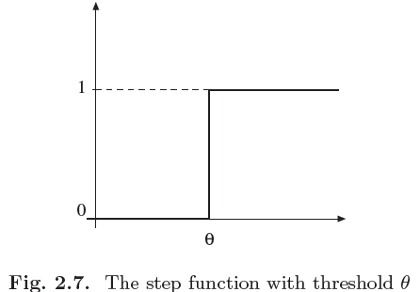
Threshold Logic
© Neural Networks: A Systematic Introduction, Springer, 1996.
CS5486

Slide 54
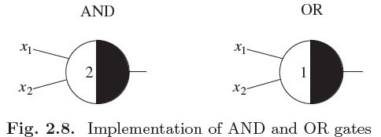
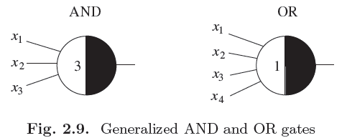
AND & OR Gates
© Neural Networks: A Systematic Introduction, Springer, 1996.
CS5486

Slide 55
AND & OR Gates
x1 | x2 | z | y
0 | 0 | 0 | 0
0 | 1 | 0 | 0
1 | 0 | 0 | 0
1 | 1 | 1 | 1
x1 | x2 | z | y
0 | 0 | 0 | 0
0 | 1 | 1 | 1
1 | 0 | 1 | 1
1 | 1 | 1 | 1
CS5486

Slide 56
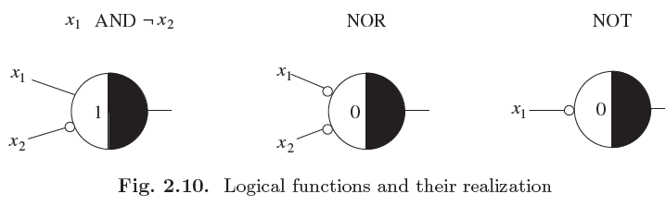
Other Logic Functions
© Neural Networks: A Systematic Introduction, Springer, 1996.
x1 | x2 | z | y
0 | 0 | 0 | 0
0 | 1 | 0 | 0
1 | 0 | 1 | 1
1 | 1 | 0 | 0
x1 | x2 | z | y
0 | 0 | 1 | 1
0 | 1 | 0 | 0
1 | 0 | 0 | 0
1 | 1 | 0 | 0
x | z | y
0 | 1 | 1
1 | 0 | 0
CS5486

Slide 57
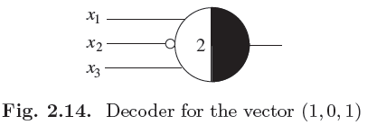
A Decoder
© Neural Networks: A Systematic Introduction, Springer, 1996.
x1 | x2 | x3 | z | y
1 | 0 | 1 | 1 | 1
Otherwise |  |  | 0 | 0
CS5486

Slide 58
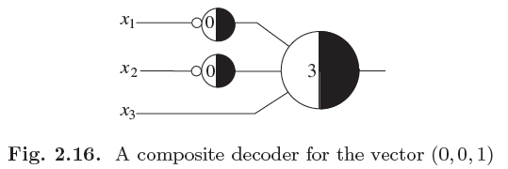
Another Decoder
© Neural Networks: A Systematic Introduction, Springer, 1996.
x1 | x2 | x3 | z | y
0 | 0 | 1 | 1 | 1
Otherwise |  |  | 0 | 0
CS5486

Slide 59
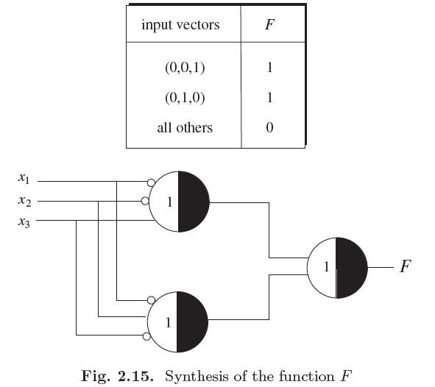
Another Decoder
© Neural Networks: A Systematic Introduction, Springer, 1996.
CS5486

Slide 60
Threshold Logic Units
Proposition: Any logical function F: {0, 1}^{n}
-> {0, 1} can be implemented with a two-layer McCulloch-Pitts network.
Proposition: Uninhibited threshold logic units of McCulloch-Pitts type can only implement monotonic logical functions.
CS5486

Slide 61
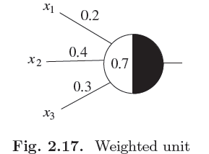
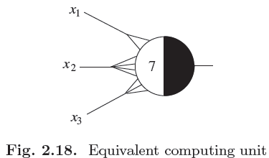
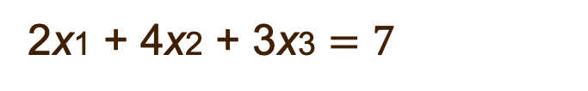
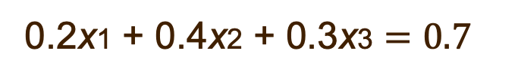
Weighted Connections
0.2x1 + 0.4x2 + 0.3x3 $=0.7$
2x1 + 4x2 + 3x3 $=7$
© Neural Networks: A Systematic Introduction, Springer, 1996.
CS5486

Slide 62
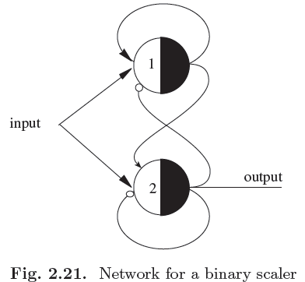
A Recurrent Network
© Neural Networks: A Systematic Introduction, Springer, 1996.
CS5486

Slide 63
Finite Automata
An automaton is an abstract device capable of assuming different states which change according to the received input and previous states.
A finite automaton can take only a finite set of possible states and can react to only a finite set of input signals.
CS5486

Slide 64
Finite Automata & Recurrent Networks
Proposition: Any finite automaton can be simulated with a recurrent network of McCulloch-Pitts units.
CS5486

Slide 65
Perceptron
A single adaptive layer of a feedforward network of pure threshold logic units.
Developed by Rosenblatt at Cornell University in the late ’50s.
Trained for pattern classification.
First working model implemented in electronic hardware.
CS5486

Slide 66
Perceptron
© Neural Networks: A Systematic Introduction, Springer, 1996.
CS5486

Slide 67
Perceptron
© Neural Networks: A Systematic Introduction, Springer, 1996.
CS5486

Slide 68
Simple Perceptron
A simple perceptron is a computing device with a threshold logic unit. When receiving n real inputs thru connections with n associated weights, a simple perceptron outputs 1 if the net input of weighted sum is not less than the threshold, and outputs 0 otherwise.
CS5486

Slide 69
Linear Separability
Two sets of data in an n-dimensional space are said to be (absolutely) linearly separable if n+1 real weights (including a threshold) exist such that the weighted sum of a datum in one set is always greater than or equal to (greater than but not equal to) the threshold and that in the other set is always less than the threshold.
CS5486

Slide 70
Absolute Linear Separability
If two finite sets of data are linearly separable, they are also absolutely linearly separable.
CS5486

Slide 71
Perceptron Convergence Algorithm
Initialize weights and threshold randomly.
Calculate actual output of the perceptron:
For all p
Adapt weights: for all p
Repeat until w converges.
CS5486

Slide 72
Learning Rule
CS5486

Slide 73
Iterative learning
Ref: R. P. Lippmann, "An Introduction to Computing with Neural Nets," IEEE ASSP Magazine, vol. 4, no. 2, pp. 4–22, Apr. 1987.
CS5486

Slide 74
A Simple Case
© Neural Networks: A Systematic Introduction, Springer, 1996.
CS5486

Slide 75
Error Landscape
© Neural Networks: A Systematic Introduction, Springer, 1996.
CS5486

Slide 76
Learning Process
© Neural Networks: A Systematic Introduction, Springer, 1996.
CS5486

Slide 77
Threshold
© Neural Networks: A Systematic Introduction, Springer, 1996.
CS5486

Slide 78
Perceptron Convergence Theorem
If two sets of data are linearly separable, the perceptron learning algorithm converge to a set of weights and a threshold in a finite steps.
CS5486

Slide 79
Truth Table for OR Function
CS5486

Slide 80
Iteration 1
CS5486

Slide 81
Iteration 2
CS5486

Slide 82
Iteration 3
CS5486

Slide 83
Iteration 4
CS5486

Slide 84
Iteration 5
CS5486

Slide 85
Finally
CS5486

Slide 86
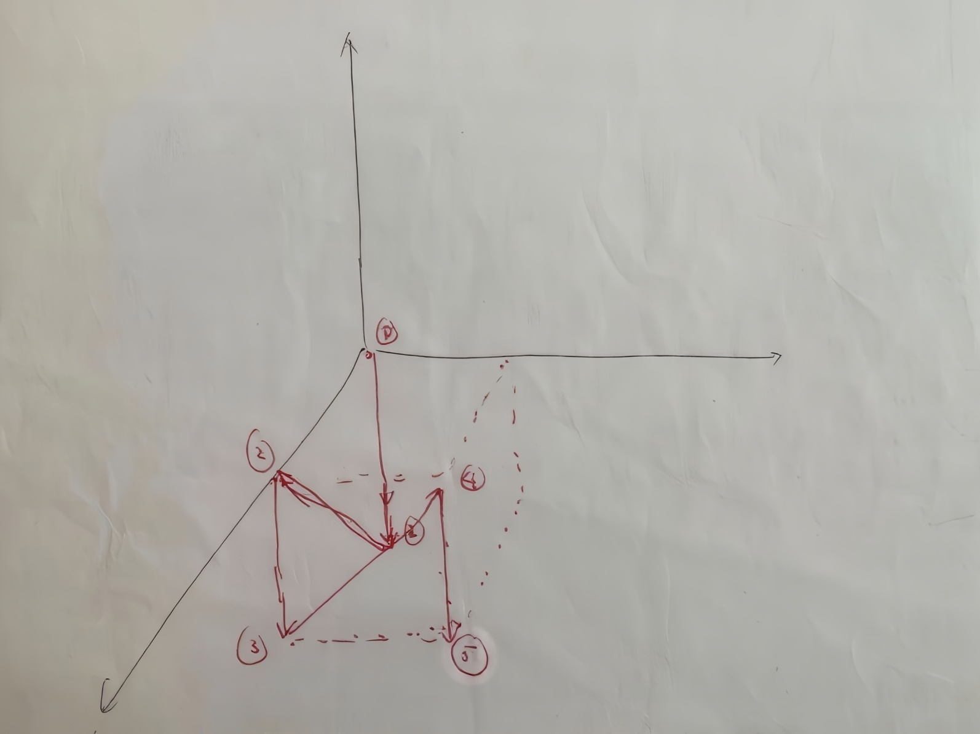
Learning Trajectory
CS5486

Slide 87
Trajectory
CS5486

Slide 88
Two-Variable Logic Functions
CS5486

Slide 89
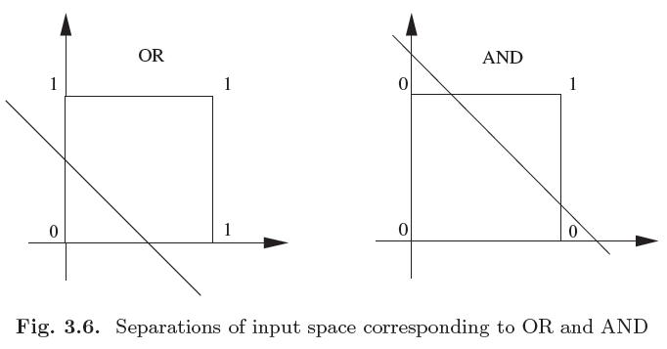
2D OR and AND
© Neural Networks: A Systematic Introduction, Springer, 1996.
CS5486

Slide 90
3D Logic Function
© Neural Networks: A Systematic Introduction, Springer, 1996.
CS5486

Slide 91
OR Function
© Neural Networks: A Systematic Introduction, Springer, 1996.
CS5486

Slide 92
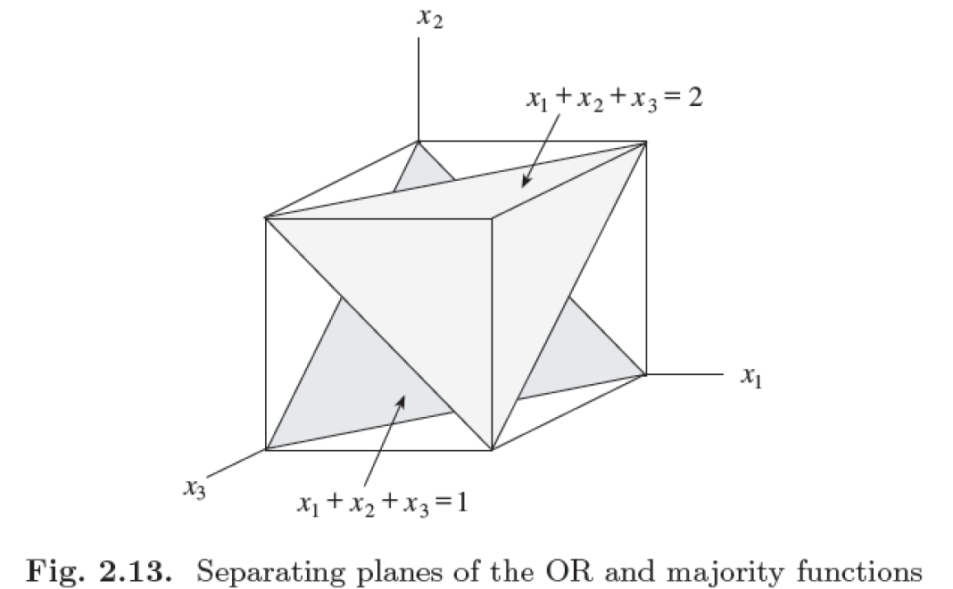
Majority Function
© Neural Networks: A Systematic Introduction, Springer, 1996.
CS5486

Slide 93
Duality
© Neural Networks: A Systematic Introduction, Springer, 1996.
CS5486

Slide 94
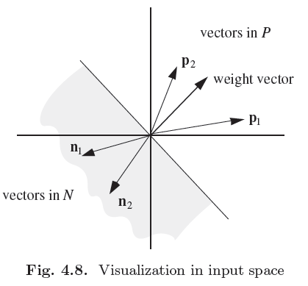
2D Weight Space
© Neural Networks: A Systematic Introduction, Springer, 1996.
CS5486

Slide 95
2D Weight Space
© Neural Networks: A Systematic Introduction, Springer, 1996.
CS5486

Slide 96
XOR Problem
© Neural Networks: A Systematic Introduction, Springer, 1996.
CS5486

Slide 97
Limitations of Perceptrons
Only linearly separable data can be classified
The convergence rate may be low for high-dimensional or large number of data.
CS5486

Slide 98
Bipolar vs. Unipolar State Variables
Unipolar:
Bipolar:
Bipolar coding of state variables is better than unipolar (binary) one in terms of algebraic structure, region proportion in weight space, etc.
CS5486

Slide 99
Monte Carlo Tests
© Neural Networks: A Systematic Introduction, Springer, 1996.
CS5486

Slide 100
ADALINE
A single adaptive layer of feedforward network of linear elements.
Full name: Adaptive linear elements.
Developed by Widrow and Hoff at Stanford University in early 60’s.
Trained using a learning algorithm called Delta Rule or Least Mean Squares (LMS) Algorithm.
CS5486

Slide 101
LMS Learning Algorithm
Initialize weights and threshold randomly.
Calculate actual output of the ADALINE:
Adapt weights:
Repeat until w converges
CS5486

Slide 102
Gradient Descent Learning Algorithms
CS5486

Slide 103
Training Modes
Series mode: input training sample pairs one by one orderly or randomly.
Batch mode: input training sample pairs in the whole training set at each iteration.
Perceptron learning: either sequential or batch mode.
ADALINE training: batch mode only.
CS5486

Slide 104
Perceptron vs. Adaline
Architecture: Perceptron uses bipolar or unipolar hardlimiter activation function, Adaline uses linear activation function.
Learning rule: Perceptron learning algorithm is not gradient-descent and can operate in either sequential or batch training mode, whereas Adaline learning (LMS) algorithm is gradient descent, but can only operate in batch mode.
CS5486

Slide 105
An Example
Consider the XOR problem in the bipolor coding
CS5486

Slide 106
An Example (cont’d)
CS5486

Slide 107
An Example (cont’d)
CS5486

Slide 108
An Example (cont’d)
CS5486

Slide 109
An Example (cont’d)
CS5486

Slide 110
Weight Space Regions
Separated by Hyperplanes
Each plane is defined by one training sample.
One plane separates two (2) half-space.
Two planes separate up to four (4) regions.
Three planes separate up to eight (8) regions.
However, four planes separate up to fourteen (14) regions only.
CS5486

Slide 111
Number of Weight Space Regions
The number of different regions in weight space defined by m separating hyperplanes in n-dimensional weight space is a polynomial of degree n-1 on m:
CS5486

Slide 112
Number of Weight Space Regions
© Neural Networks: A Systematic Introduction, Springer, 1996.
CS5486

Slide 113
Number of Logic Functions vs. Number of Threshold Functions
The number of threshold functions defined by hyperplanes is a function of 2 ^{n(n-1)} whereas that of logical functions is .
The learnbability problem: when n is large, there is not enough classification regions in weight space to represent all logical functions.
CS5486

Slide 114
Learnability Problems
Solution existence in the weight space? Neither Perceptron nor Adaline can classify patterns with nonlinear distributions such as XOR. But two-layer Perceptron can classify XOR data.
How to find the solution even though it exists in the weight space? It is known that multilayer Perceptron can classify arbitrary shape of data classes. But how to design learning algorithms to determine the weights?
CS5486

Slide 115
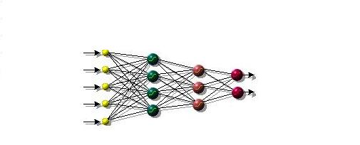
Multilayer Feedforward Network
CS5486

Slide 116
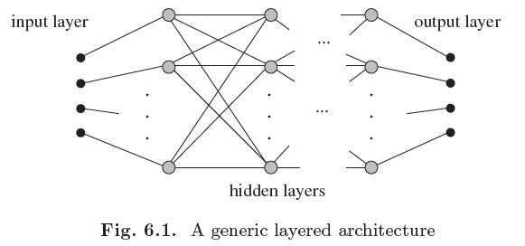
Multilayer Feedforward Network
© Neural Networks: A Systematic Introduction, Springer, 1996.
CS5486

Slide 117
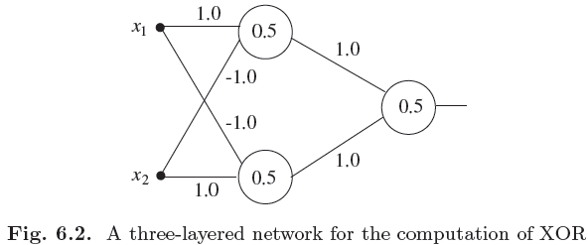
XOR Problem Solved
© Neural Networks: A Systematic Introduction, Springer, 1996.
CS5486

Slide 118
Alternative Networks
© Neural Networks: A Systematic Introduction, Springer, 1996.
CS5486

Slide 119
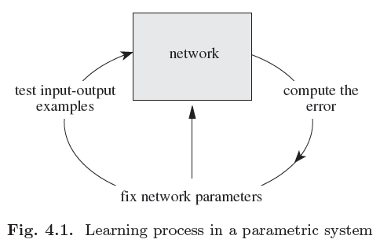
Learning Process
© Neural Networks: A Systematic Introduction, Springer, 1996.
CS5486

Slide 120
Alternative Network
© Neural Networks: A Systematic Introduction, Springer, 1996.
CS5486

Slide 121
Two-layer Separation
© Neural Networks: A Systematic Introduction, Springer, 1996.
CS5486

Slide 122
Two-layer Separation
© Neural Networks: A Systematic Introduction, Springer, 1996.
CS5486

Slide 123
Backpropagation Algorithm
Also known as generalized delta rule.
Invented and reinvented by many researchers, popularized by the PDP group at UC San Diego in 1986.
A recursive gradient-descent learning algorithm for multilayer feedforward networks of sigmoid activation function.
Compute errors backward from the output layer to input layer.
Minimze the mean squares error function.
CS5486

Slide 124
Sigmoid Activation Functions
© Neural Networks: A Systematic Introduction, Springer, 1996.
CS5486

Slide 125
Sigmoid Activation Functions
Unipolar:
Bipolar:
CS5486

Slide 126
Related Activation Functions
© Neural Networks: A Systematic Introduction, Springer, 1996.
CS5486

Slide 127
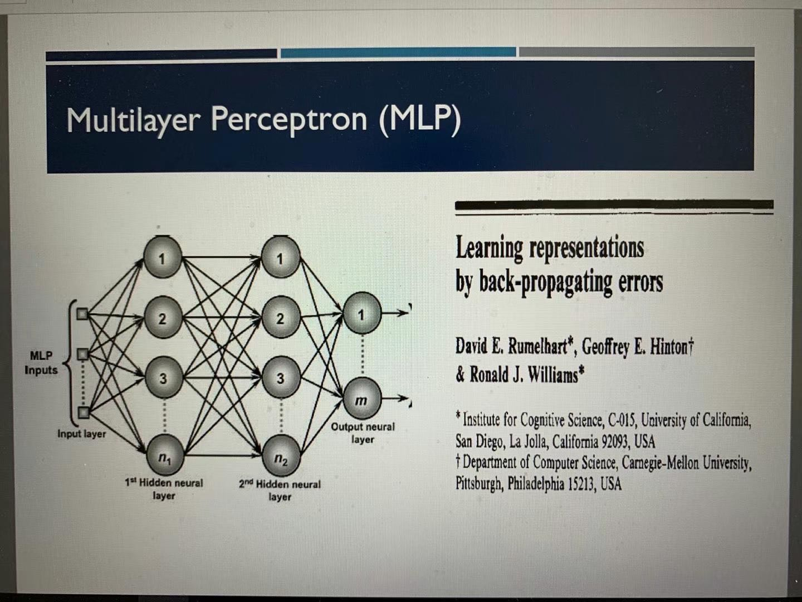
Backpropagation Algorithm
CS5486

Slide 128
Backpropagation Algorithm (cont’d)
Error function:
General formula:
CS5486

Slide 129
Backpropagation Algorithm (cont’d)
Output layer l:
where
CS5486

Slide 130
Backpropagation Algorithm (cont’d)
Hidden layer l-1:
CS5486

Slide 131
Backpropagation Algorithm (cont’d)
Input layer 1:
CS5486

Slide 132
Backpropagation Algorithm (cont’d)
Initialize weights and threshold randomly.
Calculate actual output of the MLP:
Adapt weights for all layers:
Repeat until w converges
CS5486

Slide 133
Local Minima
© Neural Networks: A Systematic Introduction, Springer, 1996.
CS5486

Slide 134
Momentum Term
To avoid local oscillation, a momentum term is sometimes added:
CS5486

Slide 135
Kolmogorov Theorem
Let f: [0, 1]^{n} -> [0, 1] be a continuous function. There exist functions of one argument g and h_{j} for j=1,2,…,2n+1 and constant w_{i} for i=1,2,…,n such that
CS5486

Slide 136
Universal Approximators
Multilayer feedforward neural networks are universal approximators of continuous functions.
A set of weights exist such that the approximation errors can be arbitrarily small.
However, the BP algorithm is not guaranteed to find such a set of weights.
CS5486

Slide 137
Overfitting Problem
© Neural Networks: A Systematic Introduction, Springer, 1996.
CS5486

Slide 138
Radial Basis Functions
A radial basis function (RBF) is a real-valued function whose value depends on the distance from its origin or center.
Related to kernel theory in statistical learning.
Used as the means for approximating or interpolating multivariate functions.
CS5486

Slide 139
Radial Basis Functions
CS5486

Slide 140
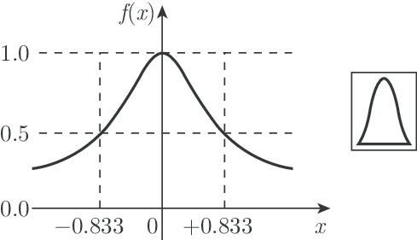
Radial Basis Functions
The most commonly used radial-basis function is a Gaussian function
In an RBF network, r is the distance from the center.
Graphically, it is a bell-shaped curve.
CS5486

Slide 141
Radial Basis Function Networks
Proposed first by Broomhead and Lowe from UK in 1988.
A linear combination of a number radial basis functions that play the role of hidden neurons.
Two-layer architecture. Its output layer uses a linear activation function as ADALINE. Its hidden layer uses radial basis activation functions.
CS5486

Slide 142
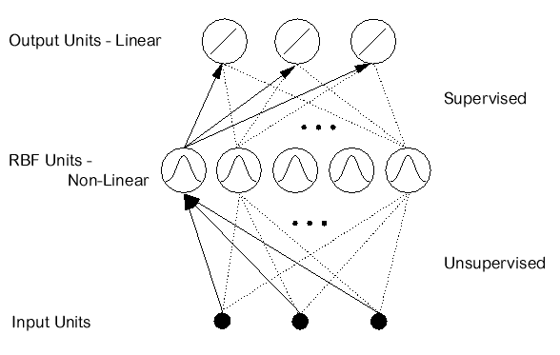
Radial Basis Function Networks
CS5486

Slide 143
Cover’s Theorem
Cover’s Theorem (1965):
A dichotomy {X⁺,X⁻} is said to be φ-separable if there exist an m-dimensional vector w such that
  w^{T} φ(x) > 0, if x in X⁺
  w^{T} φ(x) < 0, if x in X⁻
  The hyperplane defined by w^{T} φ(x) = 0 is the separating surface between the two classes.
CS5486

Slide 144
XOR Problem Revisited
An RBF network can transform the linearly inseparable XOR data in the input space to linearly separable data in the hidden state space.
CS5486

Slide 145
XOR Problem Revisited
Using a pair of Gaussian RBFs, the input patterns are mapped onto the φ₁- φ₂ plane and become linearly separable.
Let c¹ = [1,1]^{T} c² = [0,0]^{T}
CS5486

Slide 146
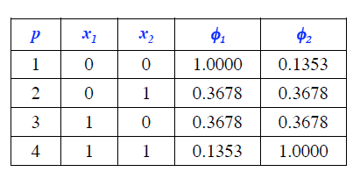
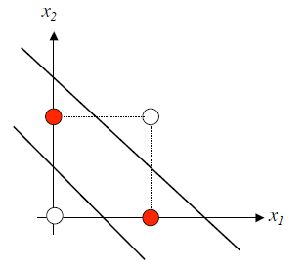
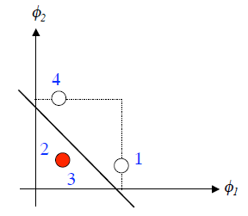
XOR Problem Revisited
CS5486

Slide 147
Functional Link Network
Proposed by Yoh-Han Pao at CWRU in late 80’s
One-layer feedforward architecture
Higher-order aggregation rule
Fast learning process
Local minima could be eliminated
Many successful stories in applications
CS5486

Slide 148
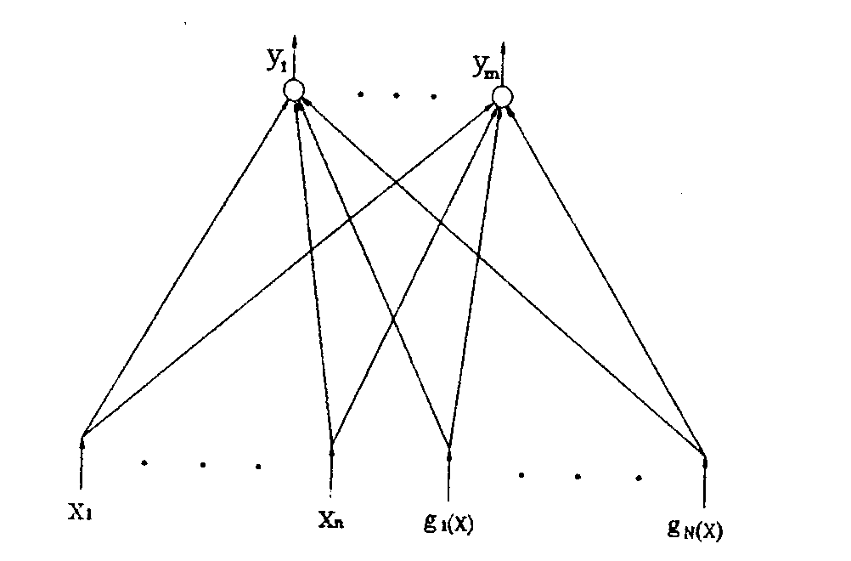
Functional Link Network
CS5486

Slide 149
Extreme Learning Machine
Proposed by Guangbin Huang at NTU in mid 2000’s
One-layer feedforward architecture
Random connection weights from inputs to hidden neurons
Fast learning process for weights in output layer.
Local minima eliminated
CS5486

Slide 150
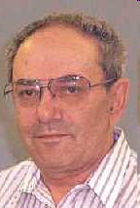
Support Vector Machine
Proposed by Vladmir Vapnik based on statistical learning and kernel theory in early 1990’s.
Minimization of structural risk.
Maximal generalization power.
V. Vapnik
CS5486

Slide 151
Linear Discriminant Function
x₂
g(x) is a linear function:
w^{T} x + b > 0
A hyper-plane in the feature space
w^{T} x + b = 0
n
(Unit-length) normal vector of the hyper-plane:
w^{T} x + b < 0
x₁
CS5486

Slide 152
Linear Discriminant Function
x₂
How would you classify these data using a linear discriminant function in order to minimize the error?
Infinite number of answers!
denotes +1
denotes -1
x₁
CS5486

Slide 153
Linear Discriminant Function
x₂
Which one is the best with maximal generalization power?
x₁
CS5486

Slide 154
Maximal Margin Classifier
x₂
The linear discriminant function (classifier) with the maximum margin is the best.
Margin
“safe zone”
Margin is defined as the width that the boundary could be increased by before hitting a data point
Why it is the best?
  Robust to outliners and thus strong generalization ability
x₁
CS5486

Slide 155
Maximal Margin Classifier
Given a set of data:
x₂
, where
With a scale transformation on both w and b, the above is equivalent to
x₁
CS5486

Slide 156
Maximal Margin Classifier
Let
x₂
Margin
x⁺
w^{T} x + b = 1
x⁺
w^{T} x + b = 0
w^{T} x + b = -1
The margin width is:
n
x⁻
Support Vectors
x₁
CS5486

Slide 157
Maximal Margin Classifier
Formulation:
x₂
Margin
x⁺
w^{T} x + b = 1
such that
x⁺
w^{T} x + b = 0
w^{T} x + b = -1
n
x⁻
x₁
CS5486

Slide 158
Maximal Margin Classifier
Formulation:
x₂
Margin
x⁺
w^{T} x + b = 1
such that
x⁺
w^{T} x + b = 0
w^{T} x + b = -1
n
x⁻
x₁
CS5486

Slide 159
Maximal Margin Classifier
Formulation:
x₂
Margin
x⁺
w^{T} x + b = 1
subject to
x⁺
w^{T} x + b = 0
w^{T} x + b = -1
n
x⁻
x₁
CS5486

Slide 160
Quadratic Programming Problem
Quadratic programming
with linear constraints
s.t.
Lagrangian
Function
s.t.
CS5486

Slide 161
Quadratic Programming Problem
s.t.
CS5486

Slide 162
Quadratic Programming Problem
s.t.
Lagrangian dual
problem
s.t.
, and
CS5486

Slide 163
Quadratic Programming Problem
From KKT condition, we know:
x₂
x⁺
w^{T} x + b = 1
Thus, only support vectors
w^{T} x + b = 0
x⁺
w^{T} x + b = -1
x⁻
The solution has the form:
Support Vectors
x₁
CS5486

Slide 164
Linear Discriminant Function
The linear discriminant function is:
It is a weighted dot product between the test point x and the support vectors x_{i}
Solving the optimization problem involved computing the dot products x_{i}^{T}x_{j} between all pairs of training samples
CS5486

Slide 165
Soft Constraints
x₂
What to do if data is not linearly separable? (noisy data, outliers, etc.)
Slack variables ξ_{i} can be added to allow mis-classification of nonlinearly distributed or noisy data
w^{T} x + b = 1
w^{T} x + b = 0
w^{T} x + b = -1
x₁
CS5486

Slide 166
Soft Constraints
Problem formulation:
subject to
Parameter C is a weight between marginal maximization and misclassification miinimization.
CS5486

Slide 167
Maximal Margin Classifier
Problem reformulation: (Lagrangian dual problem)
Subject to
CS5486

Slide 168
Nonlinear SVM
Datasets that are linearly separable with noise work out great:
0
x
But what to do if the dataset is nonlinearly distributed?
0
x
How about… mapping data to a higher-dimensional space:
x₂
0
x₁
CS5486

Slide 169
Feature Space
General idea: the original input space can be mapped to a higher-dimensional feature space where the training set is linearly separable
feature map
Φ: x → φ(x)
CS5486

Slide 170
The Kernel Trick
With this mapping, the discriminant function is now:
No need to know this mapping explicitly, because we only use the dot product of feature vectors in both the training and test.
A kernel function is defined as a function that corresponds to a dot product of two feature vectors in some expanded feature space:
CS5486

Slide 171
An Example
2-dimensional vectors x=[x₁ x₂];
let K(x_{i},x_{j})=(1 + x_{i}^{T}x_{j})²,
Need to show that K(x_{i},x_{j}) = φ(x_{i}) ^{T}φ(x_{j}):
K(x_{i},x_{j})=(1 + x_{i}^{T}x_{j})²,
= 1+ x_{i1}²x_{j1}² + 2 x_{i1}x_{j1} x_{i2}x_{j2}+ x_{i2}²x_{j2}² + 2x_{i1}x_{j1} + 2x_{i2}x_{j2}
= [1 x_{i1}² √2 x_{i1}x_{i2} x_{i2}² √2x_{i1} √2x_{i2}]^{T} [1 x_{j1}² √2 x_{j1}x_{j2} x_{j2}² √2x_{j1} √2x_{j2}]
= φ(x_{i}) ^{T}φ(x_{j}), where φ(x) = [1 x₁² √2 x₁x₂ x₂² √2x₁ √2x₂]
CS5486

Slide 172
Common Kernel Functions
  Linear kernel:
  Polynomial kernel:
  Gaussian (Radial-Basis Function (RBF) ) kernel:
  Sigmoid:
CS5486

Slide 173
Kernel Functions
For some functions K(x_{i},x_{j}) checking that
K(x_{i},x_{j})= φ(x_{i}) ^{T}φ(x_{j}) can be cumbersome.
Mercer’s theorem:
Every semi-positive definite symmetric function is a kernel
Semi-positive definite symmetric functions correspond to a semi-positive definite symmetric Gram matrix:
K(x₁,x₁) | K(x₁,x₂) | K(x₁,x₃) | … | K(x₁,x_{N})
K(x₂,x₁) | K(x₂,x₂) | K(x₂,x₃) |  | K(x₂,x_{N})
… | … | … | … | …
K(x_{P},x₁) | K(x_{N},x₂) | K(x_{N},x₃) | … | K(x_{N},x_{N})
CS5486

Slide 174
Nonlinear SVM: Optimization
Problem reformulation: (Lagrangian dual problem)
subject to
The solution of the discriminant function is
The optimization technique is the same.
CS5486

Slide 175
SVM Learning
1. Choose a kernel function
2. Choose a value for C
3. Solve the quadratic programming problem (many software packages available)
4. Construct the discriminant function from the support vectors
CS5486

Slide 176
Design Issues
Choice of kernel
- Gaussian or polynomial kernel is default
- if ineffective, more elaborate kernels are needed
- domain experts can give assistance in formulating appropriate similarity measures
Choice of kernel parameters
- e.g. σ in Gaussian kernel
- σ is the distance between closest points with different classifications
- In the absence of reliable criteria, applications rely on the use of a validation set or cross-validation to set such parameters.
Optimization criterion – Hard margin v.s. Soft margin
- a lengthy series of experiments in which various parameters are tested
CS5486

Slide 177
SVM Summary
1. Maximal Margin Classifier
  Better generalization ability & less over-fitting
2. The Kernel Trick
  Map data points to a higher dimensional space to make them linearly separable.
  Since only dot product is used, we do not need to represent the mapping explicitly.
CS5486

Slide 178
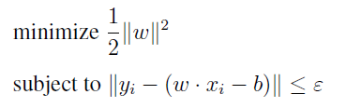
Support Vector Regression
Problem formulation
CS5486

Slide 179
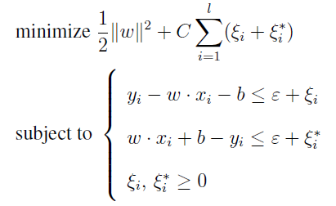
Support Vector Regression
Problem reformulation
CS5486

Slide 180
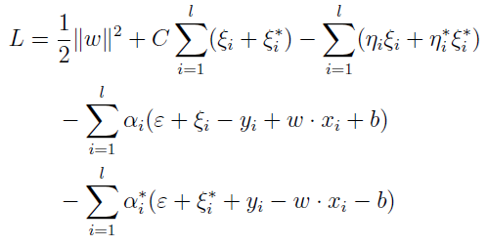

Support Vector Regression
CS5486

Slide 181
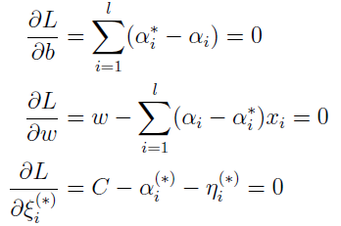
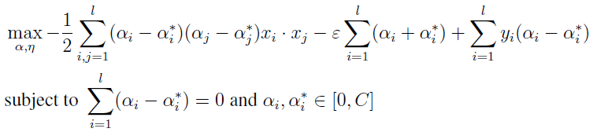
Support Vector Regression
CS5486

Slide 182

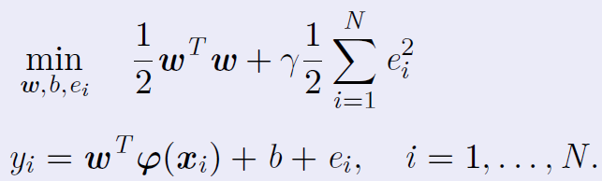
Least-squares SVM
Proposed by Suykens and Vandewalle at KUL in 1999.
Let
Primal problem formulation
CS5486

Slide 183



Least-squares SVM
Lagrangian
CS5486

Slide 184

Least-squares SVM
Final model
CS5486

Slide 185

Two-spirial Classification
Ref: J. A. K. Suykens and J. Vandewalle, "Least Squares Support Vector Machine Classifiers," Neural Processing Letters, vol. 9, no. 3, pp. 293–300, 1999.

Slide 186

Short-term Prediction
Ref: M. Espinoza, J. A. K. Suykens, R. Belmans, and B. De Moor, "Electric Load Forecasting: Using Kernel-Based Modeling for Nonlinear System Identification," IEEE Control Systems Magazine, vol. 27, no. 5, pp. 43–57, 2007.
CS5486

Slide 187
General Learning Problem
The general learning problem for a neural network consists in finding the unknown elements of a given architecture (e.g., activation functions or connection weights).
The general learning problem for a neural network is NP-complete.
CS5486

Slide 188
Unsupervised Learning
Reinforcement learning: Each input stimulus generates a reinforcement of the weights and thresholds in such a way as to enhance the reproduction of the desired output; e.g., Hebbian learning.
Competitive learning: The elements of the the neural network compete with each other for the right to produce the output associated with an input stimulus; e.g., Kohonen learning.
CS5486

Slide 189
Competitive Learning
Let X={x¹,x²,…,x^{P}} be a set of n-vector to be grouped into K clusters.
Initialize weights and threshold randomly.
Calculate w_{i}^{T}x^{j} with a random x^{j} from X for
j = 1, 2, …, K.
Select w_{max} such that w_{max} x^{j}= max_{i}{w_{i} x^{j}}.
Adapt weights by
Repeat until w convergence
CS5486

Slide 190
Energy Function in Competitive Learning
The energy function of a set X = {x¹, x²,…x^{q}} of n-vectors is given by
where w is an n-dimensional weight vector.
CS5486

Slide 191
MAXNET
A sub-network for selecting the input with maximum value - winner takes all.
By means of mutually prohibition, a MAXNET keeps the maximal input and presses down the rest.
It is often used as the output layer in some existing neural networks
CS5486

Slide 192
MAXNET
A recurrent neural network with self excitatory connections and laterally inhibitory connections.
The weight of self excitatory connections is 1.
The weight of self inhibitory connections is -w where w<1/m, and m is the number of output neurons.
CS5486

Slide 193


kWTA Model
CS5486

Slide 194


Desirable Properties
The kWTA model with Heaviside activation function has been proven to be globally stable and globally convergent to the kWTA solutions in finite time.
Derived lower and upper bounds of convergence time are respectively
CS5486

Slide 195

Simulation Results
Randomized Integer Inputs
CS5486

Slide 196

Simulation Results
Low-Resolution Inputs
CS5486

Slide 197
Clustering
物以类聚
人以群分
CS5486

Slide 198


Clustering
Clustering or cluster analysis is to group similar data based on a given similarity measure.
It is subjective without unique solutions.
It is done via unsupervised learning.
CS5486

Slide 199
ART1 Network
Invented by Stephen Grossberg at Boston University in 1970’s.
Used to cluster binary data w/ unknown cluster number.
A two-layer recurrent neural network.
MAXNET serves as its output layer.
Bidirectional adaptive connections called bottom-up and top-down connections.
CS5486

Slide 200
ART1 Architecture
top down
bottom up (normalised)
CS5486

Slide 201
ART1 for Clustering
Initialize weights:
Compute net input for an input pattern x^{p}:
Select the best match using the MAXNET
Vigilance test: If ,
then next; otherwise, disable neuron k and go to step 2).
Adapt weights:
CS5486

Slide 202
Vigilance Parameter in ART1 Network
Value ranges between 0 and 1.
A user-chosen design parameter to control the sensitivity of the clustering.
The larger its value is, the more homogenous the data are in each cluster.
Determine in an ad hoc way.
CS5486

Slide 203
Vigilance Parameter in ART1 Network
Vigilance sets granularity of clustering
It defines basin of attraction of each cluster
Low threshold
  Large mismatch accepted
  Few large clusters
High threshold
  Small mismatch accepted
  Many small clusters
  Higher precision
Small ρ, imprecise
Large ρ, fragmented
CS5486

Slide 204

Illustrative Example
R. P. Lippmann, "An Introduction to Computing with Neural Nets," IEEE ASSP Magazine, vol. 4, no. 2, pp. 4–22, 1987.
CS5486

Slide 205
Hopfield Networks
Invented by John Hopfield at Princeton University in 1980’s.
Used as associative memories or optimization models.
Single-layer recurrent neural networks.
The discrete-time model uses bipolar threshold logic units and the continuous-time model uses unipolar sigmoid activation function.
CS5486

Slide 206
Hopfield Networks
The Hopfield networks are the classical recurrent neural networks.
John Hopfield, “Neural networks and physical systems with emergent collective computational abilities,” PNAS, USA, vol. 79, 1982.
“As far as public visibility goes, the modern era in neural networks dates from the publication of this paper.” – J. A. Anderson and E. Rosenfeld (1988).
CS5486

Slide 207

Hopfield Networks
CS5486

Slide 208
Discrete Hopfield Network
CS5486

Slide 209
Stability Analysis
CS5486

Slide 210
Stability Conditions
Stability:
Sufficient conditions:
1.
2. Activation is conducted asynchronously; i.e., the state updating from v(t) to v(t+1) is performed for one neuron each iteration.
CS5486

Slide 211
Stability Properties
If W is symmetric with zero diagonal elements and the activation is conducted asynchronously (i.e., one neuron at one time), then the discrete-time Hopfield network is stable (a sufficient condition).
If W is symmetric with zero diagonal elements and the activation is conducted synchronously, then the discrete-time Hopfield network is either stable or oscillates in a limit cycle of two states.
CS5486

Slide 212
Associative Memory
Learning and memory are the two most important cognitive functions in brain-like intelligence
As important as learning
Also known as content-addressable memory
Fundamentally different from the existing computer memory
CS5486

Slide 213
Associative Memory
Memory is a process of acquiring and storing information such that it will be available when needed.
It is well known that human memory is far more robust and fault tolerant than existing computer memory.
CS5486
213

Slide 214

Human Brain and Memory
Figure courtesy of the Frontotemporal dementia group (FRONTIER), Prince of Wales Medical Research Institute, Sydney NSW 2031 Australia
214

Slide 215
Associative Memory
As the original source of human intelligence, the brain has a powerful ability of association.
Associative memories are content-addressable mechanisms for storing prototype patterns such that the stored patterns can be retrieved with the recalling probes (cues).
CS5486
215

Slide 216
Associative Memory
When given a probe (e.g., noisy or corrupted version of a prototype pattern), the retrieval dynamics of an associate memory should converge to an equilibrium representing the prototype pattern.
In associative memories, the stored patterns are associated with their retrieval probes internally in a robust and fault-tolerant way.
CS5486
216

Slide 217
Auto-association vs.
Hetero-association
There are two types of associative memories: auto-associative and hetero-associative memories.
An auto-associative memory retrieves a previously stored pattern that closely resembles the recalling probe.
In a hetero-associative memory, the retrieved pattern is generally different from the probe in content or format.
CS5486
217

Slide 218
Auto-association vs.
Hetero-association
Hetero associative Auto associative
A
α
A
A’
B
β
B
B’
For example,
A
A
ID Name
CS5486
218

Slide 219


Hetero-Associations
Albert
Einstein
Input pattern desired output
Charles
Kao
.
.
.
.
.
.
Feed forward neural networks
Recurrent neural networks
Images Names
CS5486
219-

Slide 220
Memory Processes
Storage (Information encoding)
Given a set of prototype patterns to be memorized, place them into the memory indefinitely.
Retrieval (Information decoding)
Given any probe (key or cue), recall the corresponding prototype patterns in the memory.
CS5486
220

Slide 221
Discrete Hopfield Network as an Associative Memory
Storage: Outer product weight matrix
Retrieval (recall):
CS5486

Slide 222
Discrete Hopfield Network as an Associative Memory
If s^{p} is orthonormal; i.e.,
then the second term in recall formula (cross-talk or noise) is zero.
If , then v(1)= s^{q}
If s^{p} is not orthonormal, for a small variation of probe patterns, the Hopfield network can still recall the correct patterns.
CS5486

Slide 223


Illustrative Example
Stored
Patterns
Memory
Recall
CS5486

Slide 224
Limitations
  Very limited capacity: , where n is the memory length
  Many spurious states; e.g.,
CS5486

Slide 225
Discrete Hopfield Network as an Optimization Model
Formulate the energy function according to the objective function and constraints of a given optimization problem.
Form a Hopfield network, then update the states asynchronously until convergence.
Shortcoming: slow convergence due to asychrony.
CS5486

Slide 226
Bidirectional Associative Memories (BAM)
Also known as hetero-associative memories and resonance networks.
A generalization of auto-associative memories.
Proposed by Bart Kosko of University of Southern California in 1988.
Using bipolar signum activation functions.
CS5486

Slide 227

BAM Architecture
© Neural Networks: A Systematic Introduction, Springer, 1996.
CS5486

Slide 228
Bidirectional Associative Memories (BAM)
CS5486

Slide 229
Continuous Hopfield Network
CS5486

Slide 230

Continuous Hopfield Network
Continuous-time model [Hopfield, PNAS, vol. 81, 1984]
CS5486

Slide 231




Continuous Hopfield Network

Slide 232
Stability Analysis
CS5486

Slide 233
High Gain Unipolar Sigmoid Activation Function
CS5486

Slide 234
Continuous Hopfield Network as an Optimization Model
Formulate the energy function according to the objective function and constraints of a given optimization problem.
Synthesize a continuous-time Hopfield network, then an equilibrium state is a local minimum of the energy function. .
CS5486

Slide 235
Traveling Salesman Problem
Find a complete route by visiting each city once and only once.
Checking out all possible routes: (N – 1)!/2
For example, N = 30 => 4.4 x 10³⁰ routes
If we compute 10¹² routes per second => we need10¹⁸ seconds or 31,709,791,984 years!
In most practical problems N >> 30
A continuous Hopfield network can compute a good solution to the TSP in a parallel and distributed manner.
CS5486

Slide 236

Vertex Path Representation
The Hopfield network approach to the TSP involves arranging the neurons in such a way that they represent the decision variable for an N-city problem we would require N² neurons
N of them will be turned ON with the remainder turned OFF
CS5486

Slide 237
Vertex Path Representation
CS5486

Slide 238
Objective Function and Constraints
Constraints (permutation matrix):
  One neuron should be on in each row
  One neuron should be on in each column
Objective function:
  Total distance should be minimized
Determine the network weights and bias so that the Lyapunov function is minimized when constraints are met and objective function is minimum
CS5486

Slide 239
Objective Function to be Minimized
: binary state vaiable of the neuron in position (i,a) in the matrix or 2D array
: distance between city i and city j
Total distance of a route:
CS5486
239

Slide 240

Lyapunv Function to be Minimized
: for minimizing tour length
: is non-zero if more than one neuron in on in each row
: is non-zero if more than one neuron in on in each column
: ensure that there is a total of N neurons ON
CS5486

Slide 241

Constructing the Hopfield Network
We should select weights and currents so that two following equations become equal
  First we make output voltages double subscripts:
CS5486

Slide 242

Constructing the Hopfield Network
Note first that multiply the second-order terms and multiply first-order terms
.
First order terms should be equal:
CS5486

Slide 243

Constructing the Hopfield Network
Let’s treat the four sets of second-order terms separately
The second-order C terms are given by
➔ = - C
CS5486

Slide 244
Constructing the Hopfield Network
If , then
corresponding term is
where Kronecker delta function
Similarly,
CS5486

Slide 245


Constructing the Hopfield Network
D term contributes an amount to the Lyapunov function only when or
So
Bringing together all four components of the weights, we have
CS5486

Slide 246
Parameter Selection
Appropriate values for the parameters A,B,C,D and must be determined
Tank and Hopfield used A = B =D =250 , C = 1000 and = 50
Tank and Hopfield applied it to random 10-city maps and found that, overall, in about 50% of cases, the method found the optimum route from among the 181,440 distinct paths.
CS5486

Slide 247

Ten-City Example
CS5486

Slide 248

Optimal Route
CS5486

Slide 249

Local Minima
© Neural Networks: A Systematic Introduction, Springer, 1996.
CS5486

Slide 250
Simulated Annealing
Annealing is a metallurgical process in which a material is heated and then slowly brought to a lower temperature to let molecules to assume optimal positions.
Simulated annealing simulates the physical annealing process mathematically for global optimization of nonconvex objective function.
CS5486

Slide 251
Updating Probability
The steepest tangent of the probability function intersects with the horizontal axis at T
CS5486

Slide 252
Updating Probability
The steepest tangent of the probability function intersects with the horizontal axis at 2T.
CS5486

Slide 253

Decreasing Temperature
CS5486

Slide 254

Descending Energy
CS5486

Slide 255

Sample TSP Solution
CS5486

Slide 256
Characteristics of
Simulated Annealing
The higher the temperature, the higher the probability of an energy increase.
As the temperature approaches to zero, the simulated annealing procedure becomes an iterative improvement one.
The temperature parameter has to be lower gradually to avoid prematurity.
CS5486

Slide 257
Boltzmann Machine
A stochastic recurrent neural network invented by G. Hinton (Google now) and T. Sejnowski (Salk Institute now) in 1983.
It has binary state variables {-1, 1}^{n} with a probabilistic activation function.
It is a parallel implementation of simulated annealing procedure.
It can also be seen as a stochastic, generative counterpart of the Hopfield networks.
CS5486

Slide 258
Boltzmann Machine
CS5486

Slide 259
Mean Field Annealing Network
A deterministic recurrent neural network.
Based on mean-field theory.
Continuous state variables on [-1, 1]^{n}.
use a bipolar sigmoid activation function.
Use a gradually decreasing temperature parameter like simulated annealing.
Used for combinatorial optimization.
CS5486

Slide 260
Mean Field Annealing Network
CS5486

Slide 261
Self-Organizing Maps (SOMs)
Developed by Prof. T. Kohonen at Helsinki University of Technology (renamed to Aalto University) in Finland in 1970s.
A single-layer network with a winner-take-all layer using an unsupervised learning algorithm.
Formation of a topographic map through self-organization.
Map high-dimensional data to one or two-dimensional feature maps.
CS5486

Slide 262
Data Clusters
CS5486

Slide 263
SOM Architecture
CS5486

Slide 264
Kohonen’s Learning Algorithm
(Initialization) Randomize w_{ij}(0) for i = 1,2,…n; j = 1,2,…m; p = 1, t = 0.
(Distance) for datum x^{p},
(Minimization) Find k such that d_{k}= min_{j} d_{j}
(Adaptation)
CS5486

Slide 265

Neighborhood in SOMs
CS5486

Slide 266




A Simple Example
CS5486

Slide 267

Kohonen’s Example
CS5486

Slide 268

© Neural Networks: A Systematic Introduction, Springer, 1996.
CS5486

Slide 269
Echo State Network
Proposed by Herbert Jaeger and Harald Haas at Jocobs University in 2004.
Also called reservoir computing.
It is a recurrent neural network with sparse connections and random weights among hidden neurons.
CS5486

Slide 270
ESN Architecture
CS5486

Slide 271
State Equations
CS5486

Slide 272
Fuzzy Logic
Developed by the late Prof. Lotfi Zedeh at the University of California - Berkeley in late 1965.
A generalization of classical logic.
Fuzzy logic describes one kind of uncertainty: impreciseness or ambiguity.
Probability, on the other hand, describes the other kind of uncertainty: randomness.
CS5486

Slide 273
Membership Function
Let X be a classical set. A membership function of fuzzy set A u_{A} : X -> [0, 1] defines the fuzzy set A of X.
Crisp sets are special case of fuzzy sets where the value of the membership function are 0 and 1 only.
CS5486

Slide 274
Membership Functions
© Neural Networks: A Systematic Introduction, Springer, 1996.
CS5486

Slide 275
Membership Functions
Temp: {Freezing, Cool, Warm, Hot}
Degree of Truth or "Membership"
CS5486

Slide 276
Membership Functions
© Neural Networks: A Systematic Introduction, Springer, 1996.
CS5486

Slide 277
Fuzzy Set
Fuzzy set A is the set of all pairs (x, u_{A}(x)) where x belongs to X; i.e.,
If X is discrete,
If X is continuous,
Support set of A is
CS5486

Slide 278
Discrete Fuzzy Set
μ
（x₁）
μ
（x₂）
μ
（x₃）
μ
（x_{n}）
A
A
A
A
A
＋
＋
＋
＋
＝
x₁
x₂
x₃
x_{n}
Example: middle age
μ
（x）
F
A
1
0.8
0.2
0.1
age
32
33
34
39
40
41
47
48

Slide 279
Fuzzy Set
© Neural Networks: A Systematic Introduction, Springer, 1996.
CS5486

Slide 280
Fuzzy Set Terminology
Fuzzy singleton: A fuzzy set where its support set contain a single point only with u_{A} (x)=1.
Crossover point:
Kernel of a fuzzy set A: All x such that
u_{A} (x)=1; i.e.,
Height of a fuzzy set A: Supremum of
u_{A} (x) over x; i.e.,
CS5486

Slide 281
Fuzzy Set Terminology
Normalized fuzzy set A: Its height is unity; i.e., ht(A)=1. Otherwise, it is subnormal.
-cut of a fuzzy set A: A crisp set
Convex fuzzy set A:
i.e., any -cut is a convex set.
CS5486

Slide 282
Logic Operations on Fuzzy Sets
Union of two fuzzy sets:
Intersection of two fuzzy sets:
Complement of a fuzzy set:
CS5486

Slide 283
Logic Operations on Fuzzy Sets
© Neural Networks: A Systematic Introduction, Springer, 1996.
CS5486

Slide 284
Cardinality and Entropy of Fuzzy Sets
Cardinality: |A| is defined as the sum of the membership function values of all elements in X; i.e.,
Entropy: E(A) measures fuzziness and is defined as
CS5486

Slide 285
Cardinality of Fuzzy Sets
© Neural Networks: A Systematic Introduction, Springer, 1996.
CS5486

Slide 286
Entropy of Fuzzy Sets
© Neural Networks: A Systematic Introduction, Springer, 1996.
CS5486

Slide 287
Entropy of Fuzzy Sets
© Neural Networks: A Systematic Introduction, Springer, 1996.
CS5486

Slide 288
Logic Operations on Fuzzy Sets
Equality: For all x, u_{A}(x)=u_{B}(x)
Degree of equality:
Subset:
Subsethood measure:
CS5486

Slide 289
Properties of Fuzzy Sets
Union:
Intersection:
Double negation law:
DeMorgan’s laws:
However,
CS5486

Slide 290
Fuzzy Relations
Binary fuzzy relations are most common.
Reflexive:
Symmetric:
Transitive:
CS5486

Slide 291
Fuzzifiers and Defuzzifiers
Fuzzifier: A mapping from a real-valued set to a fuzzy by means of a membership function.
Defuzzifier: A mapping from a fuzzy set to a real-valued set.
CS5486

Slide 292
Typical Defuzzifiers
Centroid (also know as center of gravity and center of area) defuzzifier:
Center average (mean of maximum) defuzzifier:
CS5486

Slide 293
Centroid Defuzzifier
© Neural Networks: A Systematic Introduction, Springer, 1996.
CS5486

Slide 294
Linguistic Variables
Linguistic variables are important in fuzzy logic and approximate reasoning.
Linguistic variables are variables whose values are words or sentences in natural or artificial languages.
For example, speed can be defined as a linguistic variable and takes values of slow, fast, and very fast.
CS5486

Slide 295
Mamdani-type Fuzzy Systems
A type of fuzzy inference system that uses linguistic IF-THEN rules to map inputs to outputs, originally developed to mimic human control systems.
The key characteristic is that the output of each rule is a fuzzy set, which is then aggregated and defuzzified to produce a final, crisp output value.
CS5486

Slide 296
Fuzzy Inference Process
When imprecise information is input to a fuzzy inference system, it is first quantified by constructing a membership function.
Based on a fuzzy rule base, the fuzzy inference engine makes a fuzzy decision.
The fuzzy decision is then defuzzified to output for an action.
The defuzzification is usually done by using the centroid method.
CS5486

Slide 297

Fuzzy Inference Process
CS5486

Slide 298

Fuzzy Inference System
CS5486

Slide 299
An Electrical Heater Example
Rule Base:
R1: If temperature is cold, then increase power.
R2: If temperature is normal, then maintain.
R3: If temperature is warm, then reduce power.
At 12º, T = 0.5/cold + 0.3/normal/+ 0.0/warm,
A = 0.5/increase + 0.3/maintain + 0.0/reduce.
CS5486

Slide 300
An Electrical Heater Example
© Neural Networks: A Systematic Introduction, Springer, 1996.
CS5486

Slide 301
An Electrical Heater Example
© Neural Networks: A Systematic Introduction, Springer, 1996.
CS5486

Slide 302
TS-Fuzzy Systems (1/3)
A T-S (Takagi-Sugeno) fuzzy system is a type of fuzzy inference system that uses linear functions in its rule consequents to model complex, nonlinear systems.
The key characteristic is that the output of each rule is a fuzzy set, which is then aggregated and defuzzified to produce a final, crisp output value.
CS5486

Slide 303
TS-Fuzzy Systems (2/3)
Fuzzy Modeling: A nonlinear system is approximated by a set of fuzzy "IF-THEN" rules.
Rule structure: Each rule has a premise (the "IF" part) and a consequence (the "THEN" part).
Linear consequences: The consequent is a linear equation of the input variables and a constant.
CS5486

Slide 304
TS-Fuzzy Systems (3/3)
Takagi and Sugeno described a fuzzy implication R as:
R: if (x1 is μA(x1),… xk is μA(xk))
then y = g(x1, …, xk)
Output Calculation: The final output is calculated as a weighted average of the outputs of all the rules. The "weight" for each rule is determined by how well the current system state matches the premise of that rule.
CS5486

Slide 305
Type-2 Fuzzy Logic
A generalization of type-1 fuzzy logic to handle the uncertainty of membership function by using fuzzy membership function
Proposed by Prof. Zadeh in 1975 (ten years after type-1), but became popular in recent few years
CS5486

Slide 306

Ref: J. M. Mendel, "Type-2 Fuzzy Sets and Systems: An Overview," IEEE Computational Intelligence Magazine, vol. 2, no. 1, pp. 20–29, 2007.
CS5486

Slide 307

Type-2 Fuzzy System
Ref: J. M. Mendel, "Type-2 Fuzzy Sets and Systems: An Overview," IEEE Computational Intelligence Magazine, vol. 2, no. 1, pp. 20–29, 2007.
CS5486

Slide 308

Charles Robert Darwin (1/2)
(1809 – 1882)
An English naturalist,
geologist, and biologist, widely known for his contributions to evolutionary biology.
CS5486

Slide 309
Charles Robert Darwin (2/2)
He is the author of “On the Origin of Species” (1859).
His discovery is the unifying theory of the life sciences, explaining the unity and diversity of life.
The Roman Catholic Church has come to accept his theory of evolution, viewing it as compatible with faith, since 1950.
CS5486

Slide 310
Evolutionary Computation
Population-based stochastic and meta-heuristic search algorithms for global or multi-objective optimization
Motivated by the natural evolution based on Darwinist or other principles
Use collective wisdom to accomplish given tasks via efforts of many generations.
CS5486

Slide 311
Evolutionary Algorithms
Evolutionary programming (Lawrence Fogel, 1960’s)
Evolutionary strategies (Ingo Rechenberg and Hans-Paul Schiwefel, 1960’s)
Genetic algorithms (John Holland, 1970’s)
Genetic programming (John Koza,
1990’s)
CS5486

Slide 312
Genetic Algorithms
A stochastic search method simulating the evolution of population of living species.
Optimize a fitness function which is not necessarily continuous or differentiable.
A genetic algorithm generates a population of seeds instead of one in traditional algorithms.
The computation of the population can be carried out in parallel.
CS5486

Slide 313
Elements in Genetic Algorithms
A coding of the optimization problem to produce the required discretization of decision variables in terms of strings.
A reproduction operator to copy individual strings according to their fitness.
A set of information-exchange operators; e.g., crossover, for recombination of search points to generate new and better population of points.
A mutation operator for modifying data.
CS5486

Slide 314
Reproduction Operator
Sum the fitness of all the production members and call the result total fitness.
Generate a random number n between 0 and total fitness under uniform distribution.
Return the first population member whose fitness, added to the fitnesses of the preceding population members (running total), is greater than or equal to n.
CS5486

Slide 315
Crossover Operator
Select offspring from the population after reproduction.
Two strings (parents) from the reproduced population are paired with probability P_{c}.
Two new strings (offspring) are created by exchanging bits at a crossover site.
CS5486

Slide 316
Crossover Operation
© Neural Networks: A Systematic Introduction, Springer, 1996.
CS5486

Slide 317

Crossover Operation
CS5486

Slide 318
Mutation Operator
Reproduction and crossover produce new string without introducing new information into the population at bit level.
To inject new information into offspring.
Invert chosen bits randomly with a lower probability P_{m}
CS5486

Slide 319

Mutation Operation
CS5486

Slide 320
Towers of Hanoi
Towers of Hanoi puzzle: move a number of disks from one peg to another among three pegs, to restore the original piling order.
Any move must satisfy constraints: e.g., we can only move a disk that has no disk above it.
CS5486

Slide 321

Towers of Hanoi
CS5486

Slide 322

Legal Moves
CS5486

Slide 323

Towers of Hanoi
CS5486

Slide 324

Move Represenation
CS5486

Slide 325

Corresponding Moves
CS5486

Slide 326

GA Operations
CS5486

Slide 327

GA Flow Chart
CS5486

Slide 328

Optimization Process
CS5486

Slide 329
Encoder-Decoder Design
© Neural Networks: A Systematic Introduction, Springer, 1996.
CS5486

Slide 330
Encoder-Decoder Design
© Neural Networks: A Systematic Introduction, Springer, 1996.
CS5486

Slide 331
Swarm-Based Search
Swarm is better than individual
CS5486

Slide 332
Swarm Intelligence
Initialized by Gerardo Beni and Jing Wang in 1989 in the context of cellular robotic systems
Typically made up of a population of simple agents interacting locally with one another and with their environment
Typical representatives include particle swarm optimization, ant colony optimization, etc.
CS5486

Slide 333
Ant Colony Optimization
Initially proposed by Marco Dorigo in 1992 in his PhD thesis at the Polytechnic University of Milan in Italy.
The ant colony optimization algorithm (ACO) is a probabilistic technique for solving computational problems that can be reduced to finding good paths through graphs.
CS5486

Slide 334


Marco Dorigo
Bone on August 26, 1961
Free University of Brussels
CS5486

Slide 335

ACO Motivation
“When a colony of ants is confronted with the choice of reaching their food via two different routes, one of which is much shorter than the other, their choice is entirely random. However, those who use the shorter route reach the food faster and therefore go back and forth more often between the anthill and the food.”
CS5486

Slide 336

ACO Process
The green lines are the paths chosen by each ant. The blue lines are the paths it may take at each point. When the ant finishes, the pheromone levels are represented in red.
CS5486

Slide 337

ACO for TSP
CS5486

Slide 338
Particle Swarm Optimization
A robust stochastic optimization technique based on the movement and intelligence of swarms
Applies the concept of social interaction to problem solving
It uses a number of agents (particles) that constitute a swarm moving around in the search space looking for the best solution
CS5486

Slide 339
Particle Swarm Optimization
Each particle is treated as a point in a multi-dimensional space which adjusts its “flying” according to its own flying experience as well as the flying experience of other particles
Developed in 1995 by James Kennedy (social-psychologist) and Russell Eberhart (electrical engineering professor).
CS5486

Slide 340


Fathers of PSO
Russ Eberhart
James Kennedy
CS5486

Slide 341
Psychosocial Compromise
My best perf.
i-proximity
p_{i}
Here I am!
The best perf. of my neighbours
x
p_{g}
g-proximity
v
CS5486
Notes:
This may be the most important slide of this presentation, for it summarizes the core of the method.
Let’s take a bit time to comment it.
You are a particle. Sorry, I don’t mean you are quite stupid, but it is just to explain how it works.
(By the way, Jim Kennedy has designed a nice game in which you compete with such stupid particles. I have it here, and if we have time, you will see it is almost impossible to beat it.)
You can compute how good is your position (that is to say you can compute the objective function at the place you are). You remember the best position you ever found (and the objective function value). You can ask your neighbours for this information they also have memorized, and choose the best one.
Now, you have three tendancies,
- audacious, following your own way (just using your own velocity)
- conservative, going back more or less towards your best previous position
- sheeplike, going more or less towards your best neighbour
What PSO formalizes is how to combine these tendancies in order to be globally efficient.

Slide 342
Search Direction
At each time step t
Randomness inside the loop
for each particle
for each component i
update the velocity
then move
CS5486
Notes:
Here is the pseudo code of the algorithm.
As you can see the randomness is inside the loop on components.
As a result, when I say the particle is going towards its best previous position, it means in fact “towards a point which is around its best previous position”, that is to say a point within a given proximity.
And the same for the best previous position in the neighbourhood.
Let us see more precisely what it means.

Slide 343
Random Proximity
i-proximity
p_{i}
g-proximity
x
p_{g}
v
CS5486
Notes:
Each random term defines a hyperparallelepiped inside the search space.
As you can see, it means that the “proximity area” around a given point is in fact biase (the point is not on the center). Nevertheless, the algorithm is so robust that it works quite good despite this bias, but, as you can guess, it can be improved by defining non biased proximities, namely hyperspheres. We will see that if we have time, but we can already tell that the bias is increasing with the search space dimension.
In a way, this slide could be the end of this mini tutorial, for you have now all what you really need to write your own Particle Swarm optimiser.
Now, of course, if you want to write a good one, some technical details are important. Also if you want to use PSO with non classical search spaces or non classical objective functions, discrete ones, in particular.
Before to see these points and some others, just have a look at a small animation.

Slide 344
Global Optimization
max
y
min
fitness
x
search space
CS5486

Slide 345
Global Optimization
max
y
min
fitness
x
search space
CS5486

Slide 346
Global Optimization
max
y
min
fitness
x
search space
CS5486

Slide 347
Global Optimization
y
max
min
fitness
x
search space
CS5486

Slide 348
Global Optimization
max
y
min
fitness
x
search space
CS5486

Slide 349
Global Optimization
max
y
min
fitness
x
search space
CS5486

Slide 350
Global Optimization
max
y
min
fitness
x
search space
CS5486

Slide 351
Global Optimization
max
y
min
fitness
x
search space
CS5486

Slide 352

Schwefel’s function
CS5486

Slide 353

Initialization Swarm
CS5486

Slide 354

Evolution after 5 Iterations
CS5486

Slide 355

Evolution after 10 Iterations
CS5486

Slide 356

Evolution after15 Iterations
CS5486

Slide 357

Evolution after 20 Iterations
CS5486

Slide 358

Evolution after 25 Iterations
CS5486

Slide 359

Evolution after 100 Iterations
CS5486

Slide 360

Evolution after 500 Iterations
CS5486

Slide 361

Search Results
Iteration | Swarm best
0 | 416.245599
5 | 515.748796
10 | 759.404006
15 | 793.732019
20 | 834.813763
100 | 837.911535
5000 | 837.965771
Global | 837.9658
CS5486

Slide 362
That’s all for this course.
See you in next semester.
Have a nice break!
CS5486

